Slide 1
Wavelets Meet Transformers: An Experimental Approach to Time Series Forecasting
Supervisor: AP Yeo Chai Kiat
Examiner: Dr Liu Siyuan
→ Presented by: Andrew Ng U2023820F
Notes:
Good morning, everyone. Thank you for joining today's session on the exciting world of time series prediction. As we delve into this topic, we'll explore how the fusion of wavelet transformation and transformer models can enhance the way we forecast the future in various fields

Slide 2






Table of contents
01 Introduction
02
Background
03
Methodology
04
Result & Discussions
05
Future Work
06
Conclusion

Slide 3

01
Introduction
Time Series Forecasting Concept and Importance
Notes:
Ever thought of the ability to peer into the future? Well think no further as machine learning models continue to evolve with frightening speeds at forecasting future events.

Slide 4

Time series Data
Sequence of data points measured at successive points in time
Holds the key to future predictions
Notes:
Let’s start of by introducing the input and target of our prediction; time series data.
Time series data is a sequence of data points measured at successive points in time. These data can be found everywhere around us, from the fluctuations in stock markets to the rhythm of wave tides. By analyzing the sequences of data, we are able to predict future events and trends. This is also known as time series forecasting

Slide 5



Time series Forecasting
Decisions Makers make proactive rather than reactive strategies
Inventory Management
Financial Risk Management
Weather Forecasts
Notes:
So, why is predicting the future crucial? Time Series Forecasting empowers decision-makers across industries to forecast future events based on historical data, enabling proactive rather than reactive strategies.
Some examples of why time series forecasting is important are as follows: a retailer managing inventory based on sales forecasts, a bank assessing financial risks, or a meteorologist predicting severe weather, the ability to accurately predict the future, shapes effective strategies and operations.

Slide 6
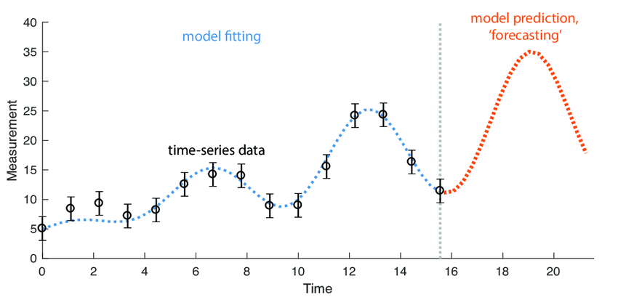
Time series Forecasting
Sequential Nature
Pattern Recognition and Statistical Techniques
Notes:
The essence of time series prediction lies in its sequential nature. Each data point is dependent on its predecessors, making the analysis a delicate dance of pattern recognition and statistical techniques. Understanding these patterns allows us to not only glimpse the future but also prepare for it with greater precision.
As we proceed, we'll explore how traditional methods have tackled these challenges and how innovative approaches like wavelet transformation and transformers can be used to enhance prediction accuracy and reliability.

Slide 7

02
Background
Traditional Methods to Modern Deep Learning Methods
Notes:
Let’s take a look at some methods used for time series forecasting

Slide 8
Prediction methods
Traditional Statistical Methods
Recurrent Neural Network
Transformers
Notes:
These are methods done in chronological order

Slide 9

Prediction methods
1. Autoregressive Integrated Moving Average (Arima)
Flexibility in modelling time series data
Data needs to be stationary
2. Exponential Smoothing
Traditional Statistical Methods
Excels in Trends and Seasonality
Effective for short term forecasts
Used in inventory control and supply chain management
Notes:
Prior to the 21st century,
Two of the most commonly used statistical methods are ARIMA and Exponential smoothing.
ARIMA models are especially favored for their flexibility in modeling a wide range of time series data. However, they require the data to be stationary, meaning the statistical properties like mean and variance should not change over time.
On the other hand, we have exponential smoothing. This technique excels in handling data with trends and seasonality by assigning exponentially decreasing weights to older observations. It’s particularly effective for short-term forecasts and has been widely used in inventory control and supply chain management.

Slide 10
Prediction methods
1. Autoregressive Integrated Moving Average (Arima)
2. Exponential Smoothing
Limitations
Non-linear patterns
Abrupt changes
Non-stationary behaviours
Traditional Statistical Methods
Notes:
While these traditional methods have been instrumental in advancing the field of time series prediction, they often struggle with complex datasets that exhibit non-linear patterns, abrupt changes, or non-stationary behaviors. This is where modern techniques, which we will explore next, begin to show their strengths.

Slide 11
Prediction methods
Traditional Statistical Methods
Recurrent Neural Network
Transformers
Notes:
The earliest modern deep learning method for forecasting uses Recurrent Neural Networks

Slide 12
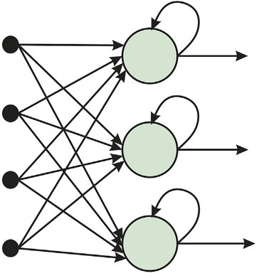
Prediction methods
Architecture
Made up of many neurons
Takes input from previous layer and step
Limitations
Vanishing and exploding gradients
Overcome using LSTMs and GRUs
Recurrent Neural Network
Notes:
RNNs represent a significant shift from static to dynamic modeling approaches. Unlike traditional methods that treat each data point as independent, RNNs recognize the sequential nature of time series data. They achieve this through their unique architecture, which allows information to persist.
In an RNN, each neuron or cell takes input not just from the previous layer, as in standard neural networks, but also from itself at the previous step. This is key to their ability to remember past information, which allows the network to make predictions based not just on the immediate input but on the history of inputs it has received.
However, RNNs are not without challenges. They are particularly prone to problems like vanishing and exploding gradients, which can hinder training and affect performance. Techniques like LSTM, or Long Short-Term Memory units, and GRUs, or Gated Recurrent Units, have been developed to overcome these issues, allowing deeper and more effective networks.

Slide 13
Prediction methods
Traditional Statistical Methods
Recurrent Neural Network
Transformers
Notes:
Building on our understanding of RNNs and their ability to handle sequences, let’s now turn our attention to a more recent breakthrough in the field of deep learning: Transformers. Originally developed for tasks in natural language processing, Transformers have rapidly become a cornerstone for many modern AI challenges, including time series prediction.

Slide 14

Prediction methods
Architecture
Self-Attention Mechanism
Benefits
Parallel Processing
Highly Scalable
Challenges
Handling long sequence data
Unable to capture and model long term dependencies efficiently
Transformers
Notes:
The core component in Transformers is its self-attention mechanism which allows for the model to focus on different parts of the input sequence in parallel, which results in faster computation times. Moreover, Transformers are highly scalable and can manage vast datasets with numerous variables, which is a common scenario in time series prediction.
However, despite its groundbreaking performance, Transformers do face some challenges. Transformers are unable to handle long sequence of data since the self-attention mechanism can struggle to capture and model long-term dependencies efficiently.
This issue occur in scenarios demanding the analysis of intricate sequences over prolonged durations, a common requirement in areas such as time series forecasting.

Slide 15
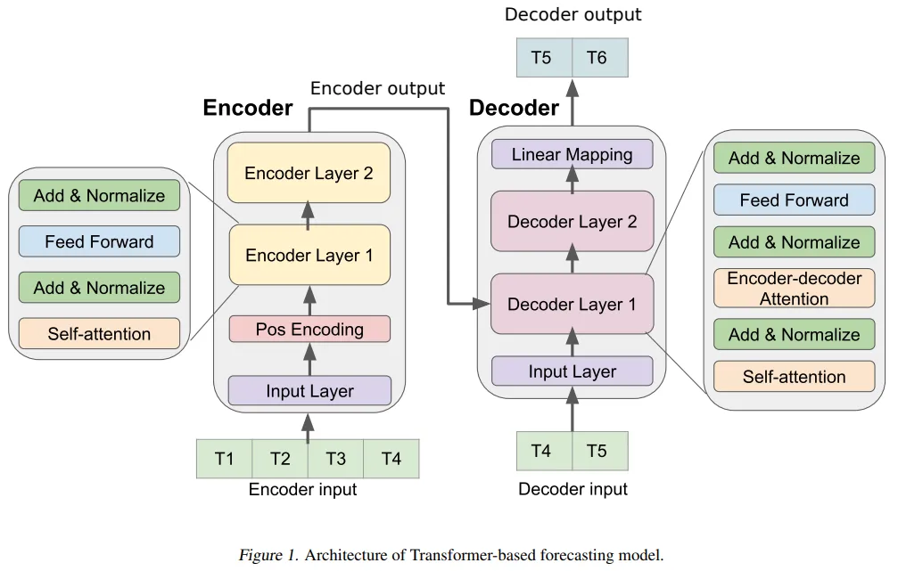
Transformer Architecture

Slide 16
Wavelet Transformation
S
Two level Wavelet Decomposition Tree
Level 1 decomposition
Coeffs = [ cA, cD ]
S – Signal
cA – Approximation Coefficients Vector
cD – Detail Coefficients Vector
cA1
cD1
Level 2 decomposition
Benefits
Provide temporal and frequency information
Reveals hidden patterns
cA2
cD2
Notes:
To address this shortcoming, the integration of advanced signal processing methods like Wavelet transformation with Transformer architectures emerges as a promising strategy.
Wavelet Transformation works by decomposing a time series into a combination of wavelets. Unlike Fourier transform that offer only frequency information, wavelets provide both temporal and frequency information. This allows analysts or models to focus on different frequencies or scales within a dataset, revealing hidden patterns that are not observable with traditional methods.

Slide 17
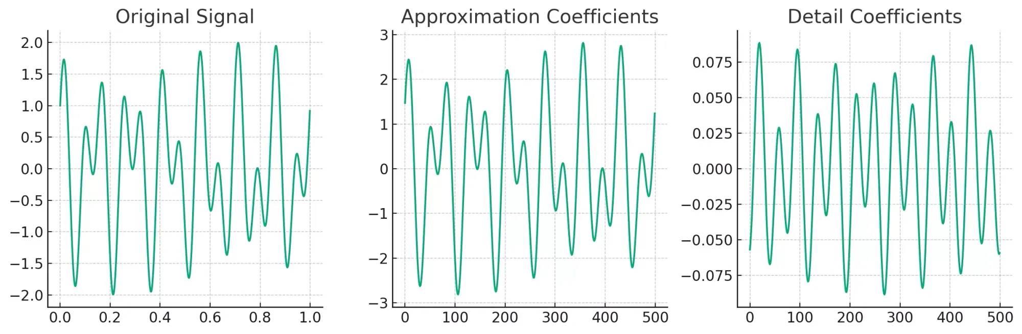
Wavelet Transformation
Long-term dependencies and patterns are highlighted
Notes:
By employing Wavelet decomposition for preliminary data processing, long-term dependencies and patterns within time series sequences are more effectively highlighted and represented in a form that enhances the Transformer's ability to learn from such data

Slide 18

03
Methodology
Datasets, Data Processing, Model Training
Notes:
Next, I would like to introduce some key steps that were done to train the transformer model

Slide 19
Datasets
England, London
London Residential Load Data
United States of America
PJM System Load Data
Spain
Energy Consumption by Spain RED Electrica de Espana
Notes:
First off, we will be using publicly available, electrical load datasets from multiple countries. Electrical data are chosen due to its highly erratic consumption details over time, making it particularly difficult for models to predict.

Slide 20
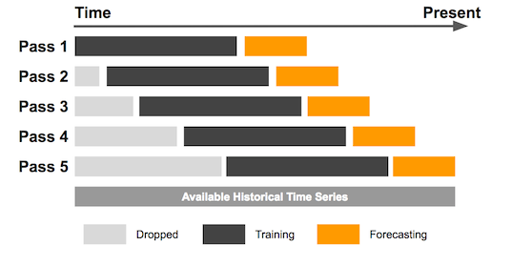
Datasets: Preparation
Sliding Window Technique
Data Normalization
Notes:
To prepare the data for the model, we will first normalize the time series over the available historical data. This decreases the range of the data and has been proven to enhance the model’s training rate and performance.
Next, we will use the sliding window technique to create smaller time sequences to exploit the power of parallel processing offered by the transformer model

Slide 21
Datasets: Train, Validate, Test
Split to a 60:20:20 ratio
Parsed through Pytorch Data Loader
Notes:
Now that we have multiple smaller time sequences, we can further classify them into training, validation and testing sets. It is important in this step that we do not randomly classify them as we have to preserve the fact that the model does not use data in the future as training. This ensures the test set remain hidden from the model and hence it will be accurate representation of the model’s performance.

Slide 22
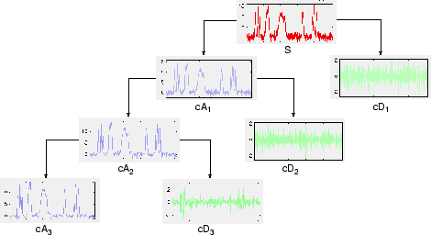
Wavelet transformation
Parameters to consider
Window
Level of decomposition
Type of wavelet decomposition
Daubechies ("db")
Haar ("haar")
Notes:
Each time sequences will then go through wavelet transformation to produce their corresponding wavelet values.
There are 3 parameters to consider during this transformation:
Window
Level of decomposition
Type of wavelet decomposition

Slide 23
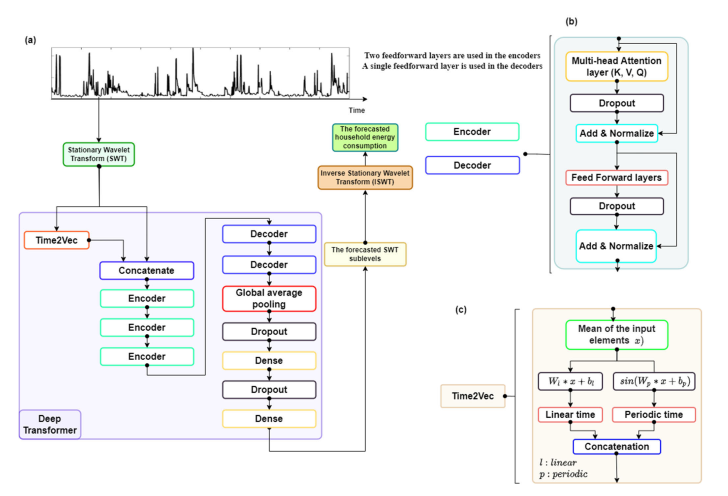
Proposed Model Architecture
Notes:
This is the proposed model architecture. The time sequence is converted into wavelet values and passed into the Transformer model.
Time2Vec block is essential to create a vector representation of time which is concatenated with the wavelets value before the self attention mechanism of the transformer starts.
The output of the transformer will the forecasted wavelet values which is passed into a function block called Inverse wavelet transform to obtain the actual forecasted value for comparison with the target.

Slide 24
Proposed model parameters
Wavelet transformation
Transformer
Parameters | Value
Window | Lookback period (x weeks)
Level | 3
Type of wavelet decomposition | Daubechies 2 ("db2")
Parameters | Value
Encoder Layers | 3
Decoder Layers | 2
Number of heads | 12
Embedding Dimension size | 256
Notes:
These are the parameters used for the wavelet transformation and our transformer model.
A quick lookback on the parameters to consider for wavelet transformation.
Given a forecast of 1 day, which is 24 time steps. Window with the value of lookback period will create a total of 24 wavelet sequences over the 24 time steps.
A level of 3 means that the time sequence is decomposed recursively up to 3 times.

Slide 25

04
Results
Model performance and Interesting Insights
Notes:
Let’s compare the results of our proposed model with other methods discussed previously

Slide 26
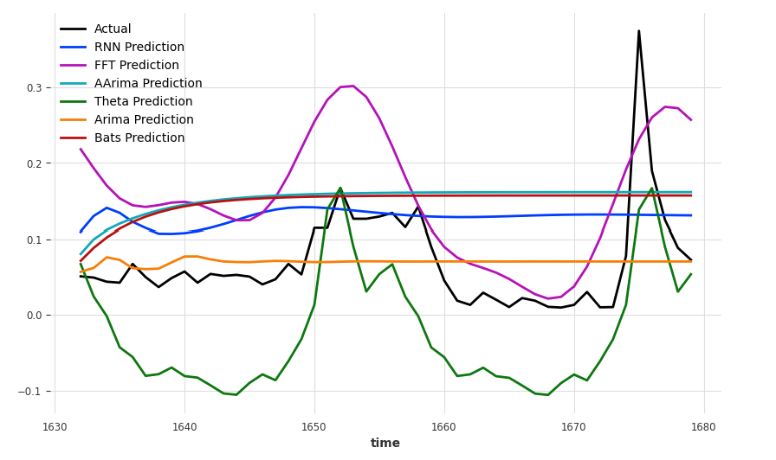
Results – Statistical Methods
London lookback 5 weeks forecast 48
Notes:
Here are the forecasted results for statistical methods. As you can see ARIMA is unable to forecast well due to the data not satisfying the stationary property.

Slide 27
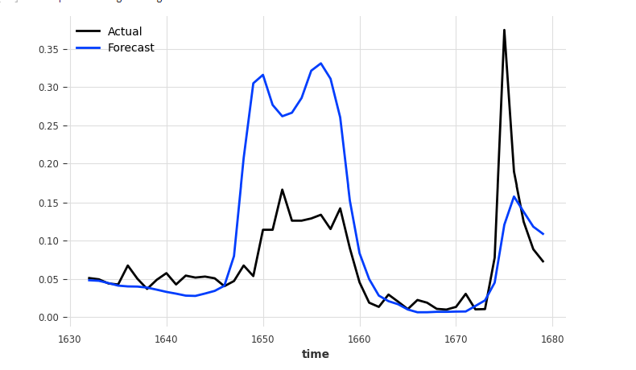
Results – Transformer
London lookback 5 weeks forecast 48
Notes:
This is the result produced by a Transformer without using wavelet transformation

Slide 28
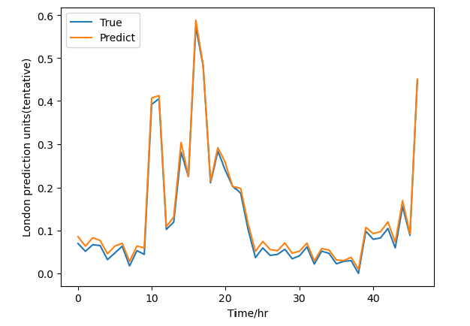
Results – Hybrid Transformer Model
London lookback 5 weeks forecast 48
Notes:
And this is the result produced by the hybrid transformer model

Slide 29
Results – Hybrid Transformer Model
London dataset with lookback of 5 weeks
London dataset with lookback of 9 weeks
Models | Forecast time steps = 48 | Forecast time steps = 168
 | RMSE | RMSE
ARIMA | 0.145756 | 0.146997
RNN | 0.153299 | 0.167148
Darts Transformer | 0.115379 | 0.124494
tsRNN 3d *** | 0.094 | 0.102
Sparse Transformer | 0.102223 | 0.102691
Hybrid SWT Transformer | 0.011432 | 0.008381
Models | Forecast time steps = 48 | Forecast time steps = 168
 | RMSE | RMSE
ARIMA | 0.113670 | 0.141457
RNN | 0.146610 | 0.164656
Darts Transformer | 0.115379 | 0.124494
tsRNN 3d *** | --- | ---
Sparse Transformer | 0.100596 | 0.102192
Hybrid SWT Transformer | 0.009605 | 0.004441
London lookback 5 weeks forecast 48
Notes:
As we can see previously from the graph, the hybrid transformer model was highly accurate. Using RMSE as our metric for comparison, we can see an overall 10x performance increase compared to other models.

Slide 30

Results – Hybrid Transformer Model
London lookback 5 weeks forecast 48
Data Leakage
Notes:
However, let’s take a look at the graph again. Given no information about the future, is it even possible to get such an accurate graph, despite using a highly erratic dataset?
Well, turns out there is a problem in time series forecasting known as data leakage. Data leakage occurs when information from the future leaks into the past during the training and validation process of time series models. This makes the model perform way better than expected since it has a glimpse of the future.

Slide 31

Hypothesis
No Covariates Used
Experiment without rolling window
Possible causes of data leaks
Covariates
Wavelet Transformation steps
Stationary Wavelet Transformation (SWT) using ‘db2’ transformation
Rolling window used to create SWT wavelets
Data leak if good results nonetheless
Notes:
Here are some possible causes of data leaks that could occur during the data processing steps, Covariates and the wavelet transformation steps. Among the transformation steps, the wavelet transformation itself could have leak some information to earlier wavelets. Next, the rolling window to create 24 wavelet sequence could have leak information too
Let’s eliminate some of these possible causes. First, no covariates was used. Covariates are variables that are not predicted by the model but is used as extra information for the model to use. For example, if we are predicting the air condition consumption, a possible covariates is the weather and temperature. Covariates can cause data leakage if there is a high correlation between itself and the prediction target. So Covariates are not a cause of data leakage in this project.
Next, we experiment with the wavelet values without rolling window. The time sequences are converted to wavelets and we use the lookback period to predict the next 24 steps at one go. If the results performs well again, we know that the transformation itself leaks data of the future to the past. Fortunately, the results show a big decrease in performance, which signals that the transformation itself does not leak data.

Slide 32
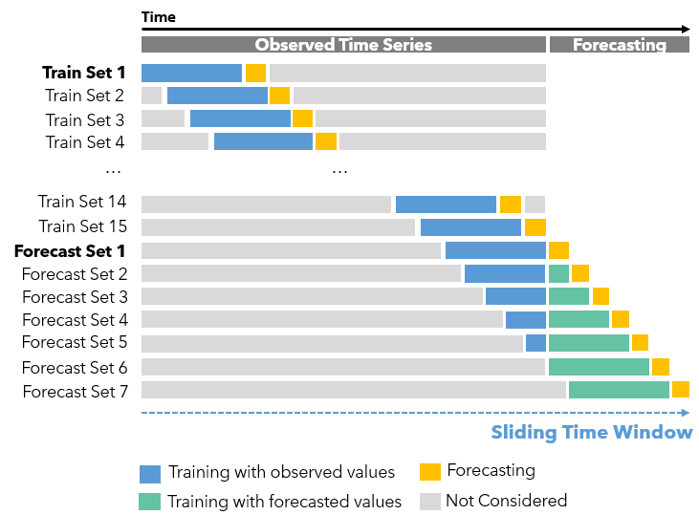
Discussions
Hypothesis
Rolling window used to create SWT wavelets
Solution
Use the Prediction window method
Notes:
Therefore, the likely cause of data leakage is from the rolling window. During the rolling window method to produce sequences for forecasting in the next 24 time steps, we are using actual observed values for forecasting.
Unless specified otherwise, to predict for the next day, we should not be using results from the next day. Therefore, the solution was to use the prediction window method. This method predicts 1 step at a time and use the predicted values as input to the next sliding window

Slide 33

Further Improvements
Using more complex Transformers
Experiment different combinations of inputs and outputs
Actual inputs to Actual outputs
Wave inputs to Actual outputs
WaveActual inputs to Actual outputs
Use multiple Transformers to train on each wavelet value and predict separately
Notes:
In addition to solving the problem of data leakage, multiple methods were combined and incorporated to further improve the performance of the transformer model. These methods are namely …

Slide 34
Results - Improvements
Dayton dataset, Data Leakage
Models | Forecast time steps = 24, lookback = 5 weeks
 | MSE | RMSE | MAE | sMAPE
DARTS Transformer | 0.003349 | 0.049119 | 0.040837 | 0.118589
Transformer (predict 24) | 0.025787 | 0.160583 | 0.133045 | 0.350473
Sparse Transformer | 0.002833 | 0.047215 | 0.0409342 | 0.115113
Transformer (pred window) | 0.018223 | 0.134993 | 0.107688 | 0.297723
Sparse Transformer (Predict 24) | 0.012121 | 0.110098 | 0.089894 | 0.256263
Sparse Transformer (Wave to Target) | 0.018295 | 0.13526 | 0.107953 | 0.297768
Sparse Transformer (WaveActual to Target) | 0.0031148 | 0.055811 | 0.043456 | 0.12338
multi MODWT Transformer | 0.0063847 | 0.0700382 | 0.063625 | 0.190151
Notes:
Here is the results after accounting for data leakage.
From the table here, we can see that using wavelets unfortunately does not increase performance of models. This is likely due to the increase in input parameters which could confuse the model. One innovative solution to note is the multi MODWT Transformer which uses multiple transformer to train on each wavelet value. While the results here is not better than Sparse transformer, the parameters used were highly not optimized due to a large increase in training time required.

Slide 35

05
Future Work
Possible Improvements and Future Research
Notes:
With that said, let’s look into the possible improvement and future research available

Slide 36
Future Work
Data processing Strategy
Transformer Library Functions
Future AI techniques
Other wavelet transformations
Expanding Window
Darts Transformer library offers more forecast alternatives
Historical Forecast
Backtracking
New AI models in the future
Time-series Generative Adversarial Networks (Time GAN)
Notes:
First, we can change our data processing strategy, there are many other wavelet transformations available. We can also change the sliding window to a expanding window strategy. This would however increase the time of training.
Next, the darts library was used to train the MODWT multi transformer model. There are more functions within the library that offers time series prediction strategies. During one of the experiments, historical forecast was proven to increase performance.
Lastly, there are new AI models proposed each year. There may be models that could utilize wavelet transformation techniques better.

Slide 37

06
Conclusion

Slide 38


Conclusion
Effect of Data Leakage
Future potential of Wavelet Transformations
Over Optimistic Results
Credibility of time series forecasting results in research papers
Partial utilization
More Sophisticated Techniques can extract more from it
Notes:
To conclude, we have seen the effect of Data leakage. It causes over optimistic results in time series prediction. Unfortunately, most research papers do not consider the problem of data leakage which results in them claiming that their model outperforms others.
Finally, wavelet transformation increases the dimensions of the input. From the results, it seems to reduce the performance of the model. However, it does not mean that the wavelet transformation is useless. It may require a more complex model or even multiple models to fully utilize the potential of wavelet transformations.

Slide 39
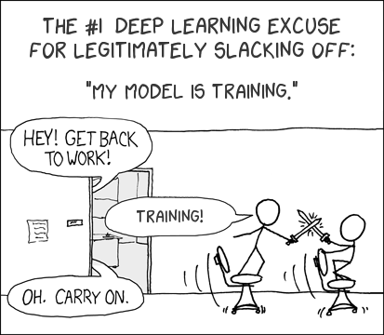
Thanks!
Do you have any questions?

Slide 40
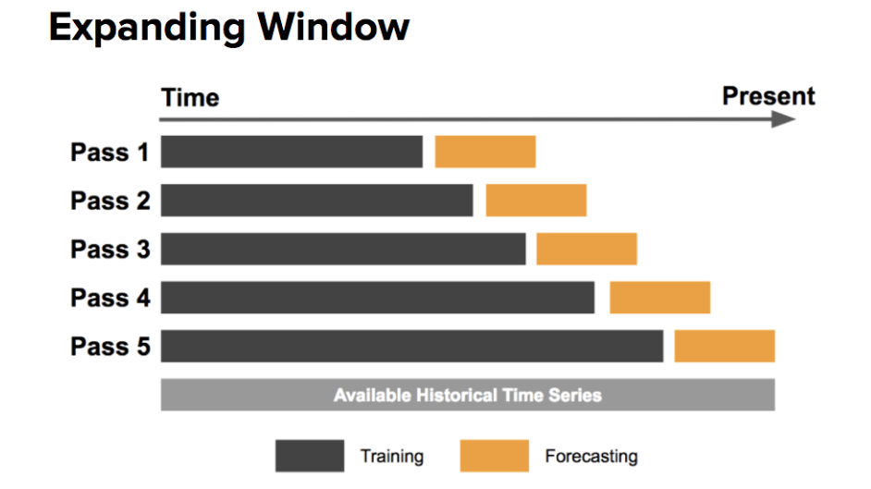
Appendix

